Slide 1

Supply Chain Data Integration System
Presented by: []
Domain: []
A practical solution to consolidate and analyze supply chain data for enhanced efficiency.

Slide 2
Project Overview
This project develops a supply chain data integration system, consolidating data from two sources using Python for transformations and a star schema in BigQuery.
1
2
3
Data Consolidation
Python Transformations
BigQuery Star Schema
Integrate data from diverse supply chain sources.
Calculate key metrics like lead time and inventory turnover.
Implement specialized data marts for analysis.

Slide 3

Primary Data Sources
Global Superstore Dataset
Inventory & Price Simulation API
Source: Kaggle (Excel file)
Entities: Orders, products, customers, returns
Source: Fake Store API + Custom Python
Refresh: One-time download with simulated updates
Entities: Products, inventory levels, price history
Refresh: API calls + simulated daily updates

Slide 4
Core Functional Requirements
1
2
3
Data Extraction & Integration
Supply Chain Metrics
Dimensional Modeling
Calculate lead time, order cycle, inventory turnover, on-time delivery.
Design star schema in BigQuery for products, locations, orders.
Build connectors, validate data, simulate incremental loads.

Slide 5
Data Extraction & Integration
Building robust connectors and ensuring data integrity across all supply chain sources.
Connectors
Inventory Simulation
Global Superstore & Fake Store API.
Realistic daily stock levels.
Data Validation
Incremental Loads
Checks for integrity and reconciliation.
Simulate ongoing data updates.

Slide 6




Supply Chain Metrics Calculation
Implementing key performance indicators to optimize supply chain operations.
Lead Time
Order Cycle Time
Order to ship date analysis.
From order to delivery.
Inventory Turnover
On-Time Delivery
Days-on-hand metrics.
Order fill rates.

Slide 7
Dimensional Modeling & Storage
Designing a robust star schema in BigQuery for efficient supply chain analytics.
Dimensions
Star Schema
Products, locations, customers, time.
BigQuery implementation.
Optimization
Fact Tables
Partitioning, clustering, aggregation tables.
Orders, shipments, inventory.

Slide 8
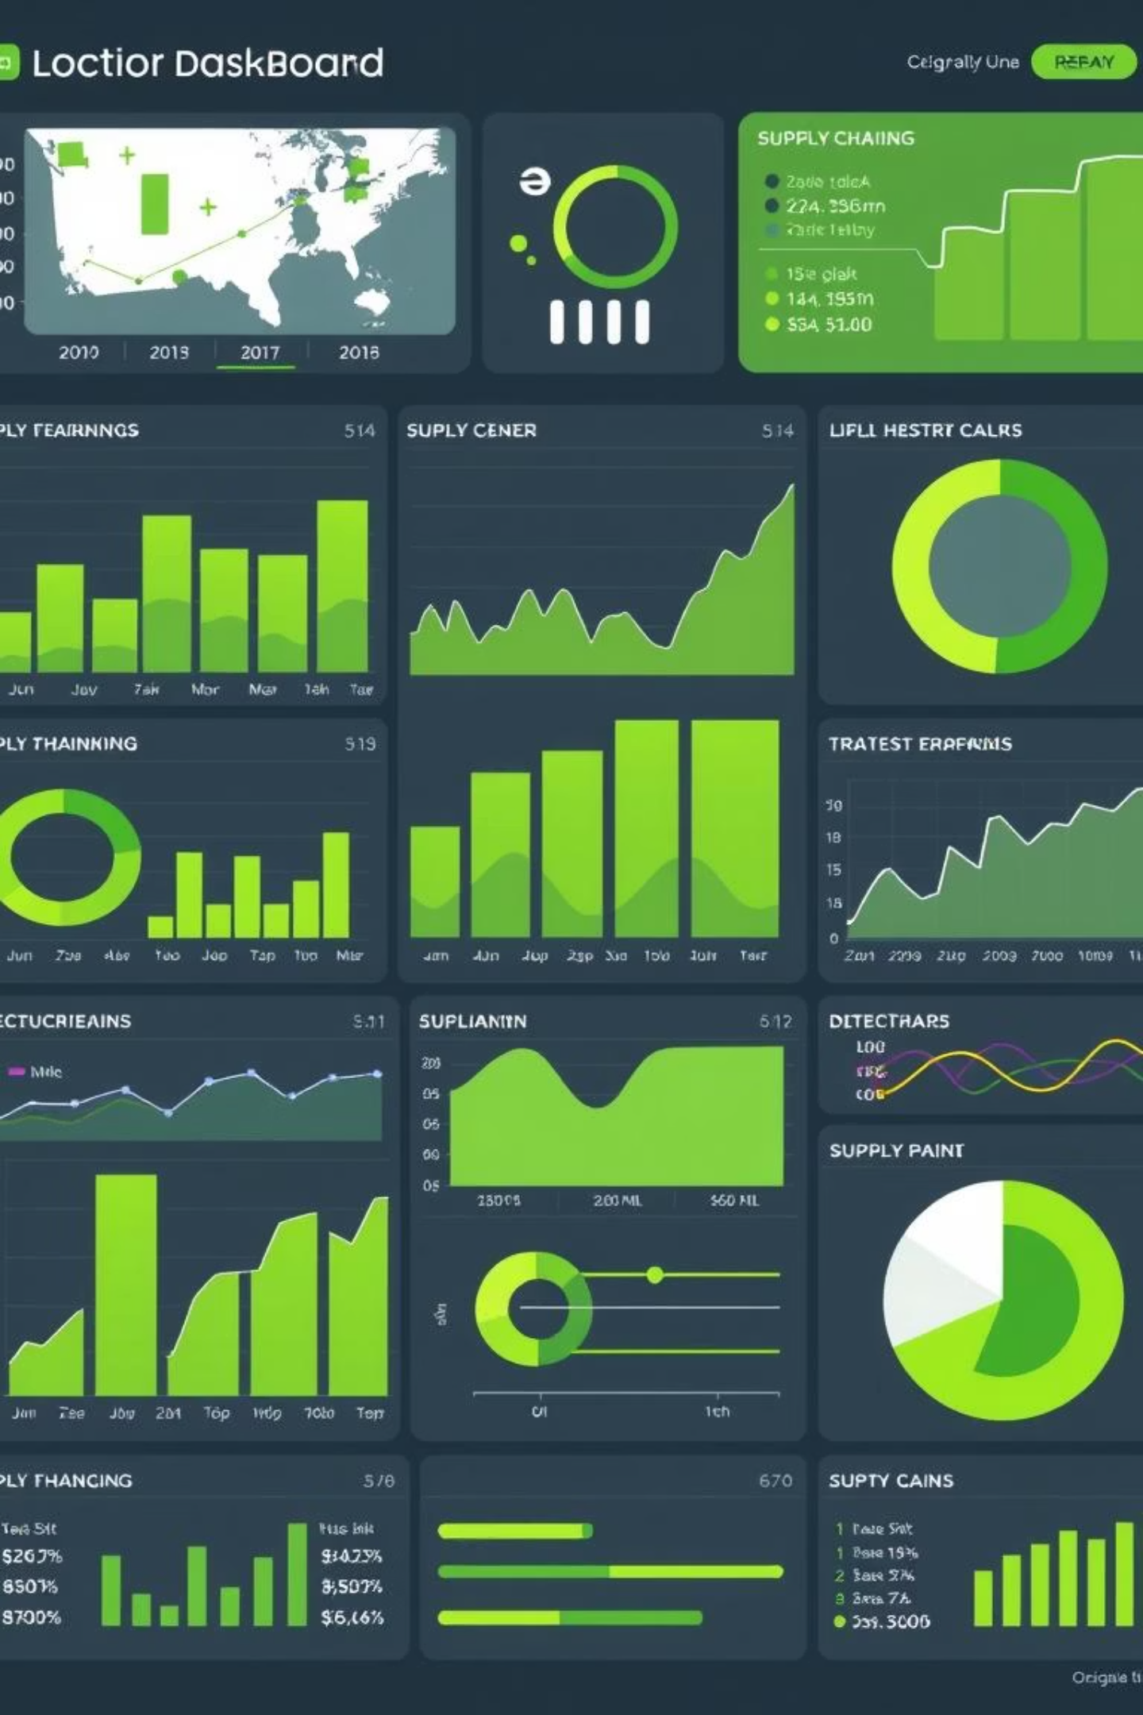
Data Marts & Analytics
Creating specialized data marts for in-depth analysis of supply chain domains.
Vendor/Supplier Performance
Product Category Performance
Inventory Analysis
Shipping & Logistics Analysis
Order Fulfillment

Slide 9
Monitoring & Visualization
Developing a Streamlit dashboard for real-time supply chain KPIs and alerting.
Streamlit Dashboard
Visualizations
Alerting
Display supply chain KPIs.
Inventory levels, product performance, shipping.
Inventory exceptions and anomalies.

Slide 10
Definition of Done
Data Pipeline
Data Warehouse & Analytics
Data loaded & processed correctly
Star schema follows best practices
API connector retrieves data
Dimensions & fact tables structured
Inventory simulation realistic
BigQuery optimized for queries
Data validation identifies inconsistencies
Data marts accurate
Metrics calculated properly
Dashboard displays KPIs accurately
Error handling & documentation complete
Alerts trigger appropriately
All metrics documented

Slide 11

Optimized Operations
This Supply Chain Data Integration System empowers your business with clear visibility and actionable insights.
Unified Data Hub
Actionable Intelligence
Scalable & Flexible
Consolidating diverse sources for a single, reliable view of your entire supply chain.
Transforming raw data into key metrics for proactive decision-making and performance optimization.
Built on BigQuery's robust architecture, ready to adapt to future growth and evolving needs.

Slide 12
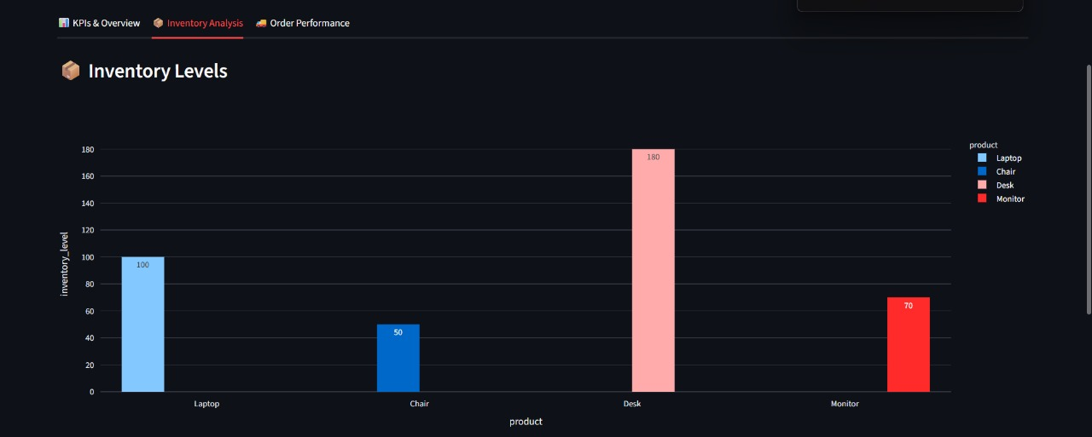
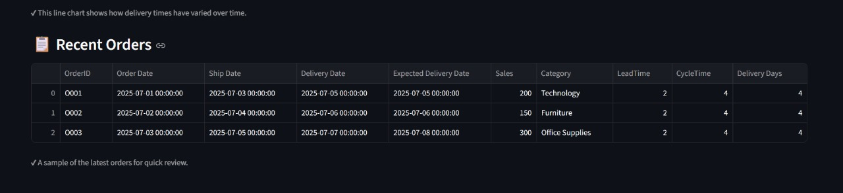
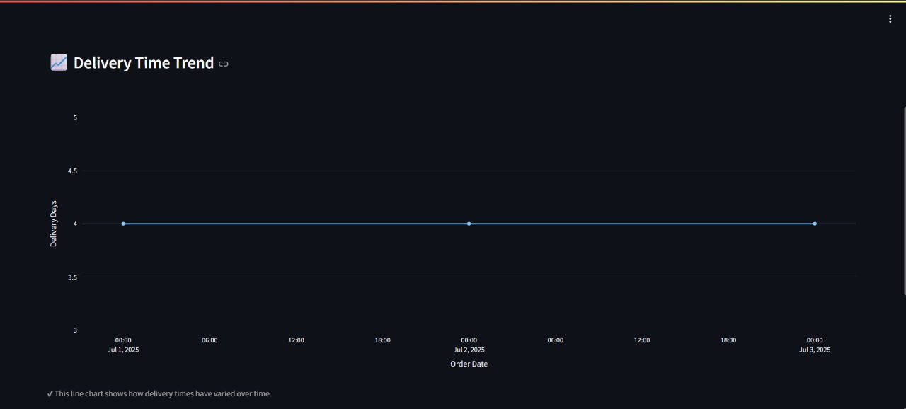
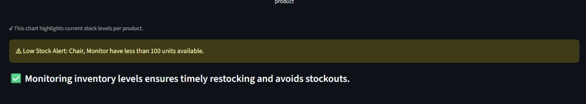

Slide 13
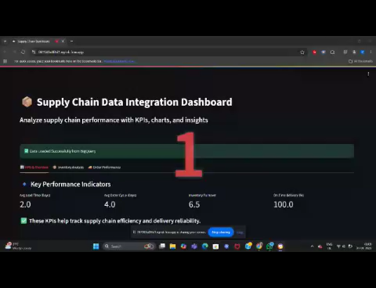
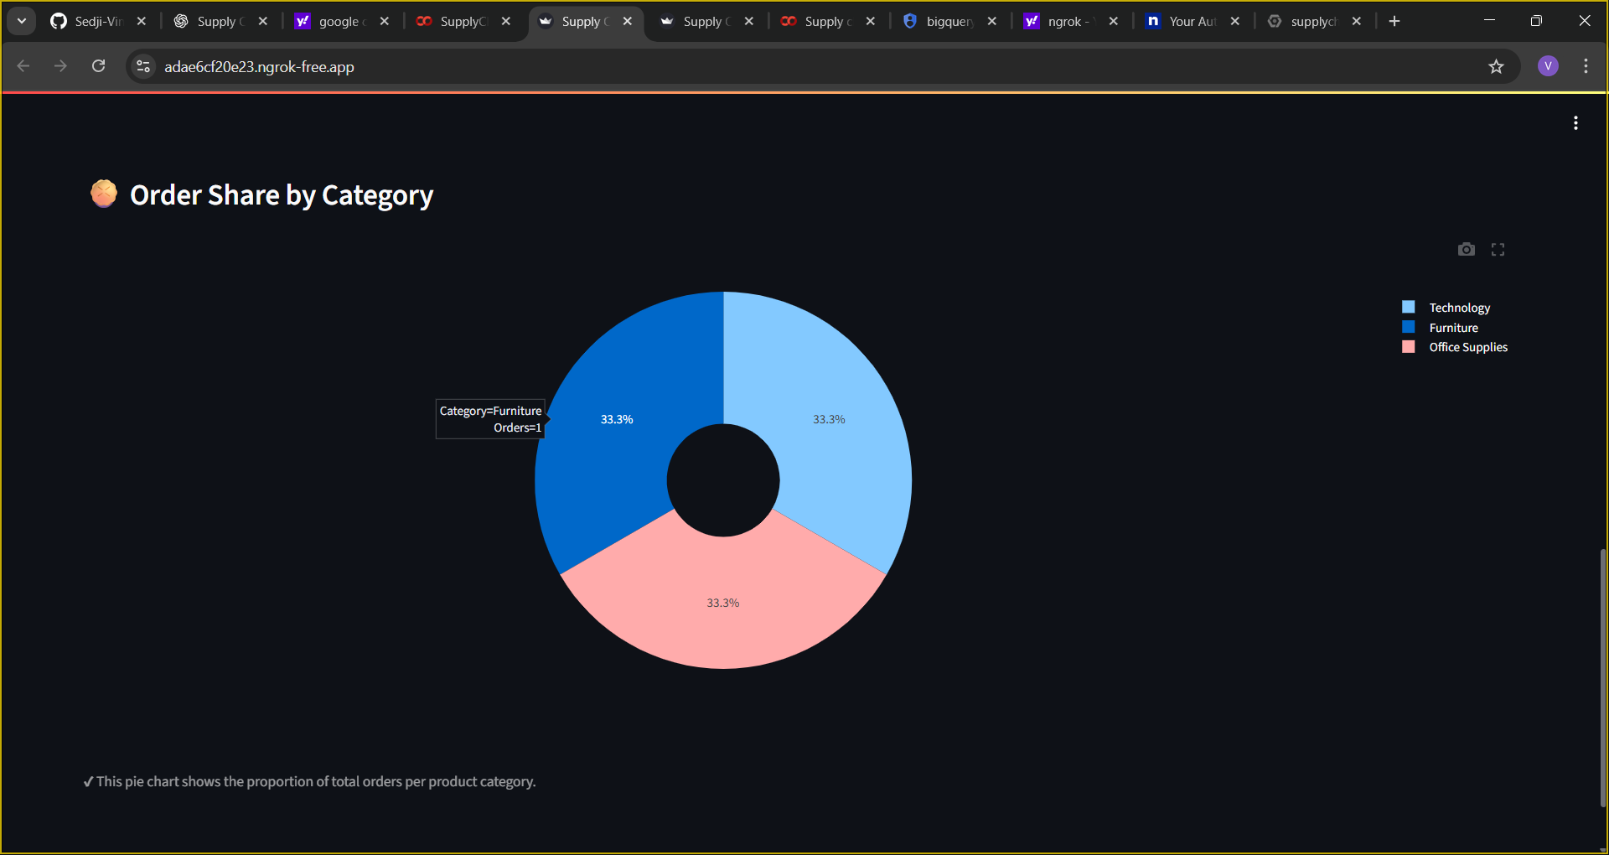

Slide 14
Thank You

